Slide 1
Memory Management

Slide 2
Outline
Background
Swapping
Contiguous Memory Allocation
Segmentation
Paging
Structure of the Page Table
Segmentation, Case study on UNIX OS

Slide 3
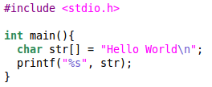
Executing Programs (Process)
Process
A program in execution
Present in the RAM
Comprises of
Executable instructions
Stack
Heap
State in the OS (in kernel)
State contains : registers, list of open files, related processes, etc.
$gcc hello.c
Process
Executable
(a.out)
$./a.out
Stored on hard disk
Executes from RAM
3
https://archive.nptel.ac.in/courses/106/106/106106144/

Slide 4
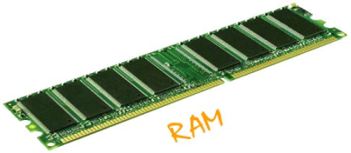
Sharing RAM
Process 1
Process 2
Process 3
Process 4
Memory map of process 1
Memory map of process 2
Memory map of process 3
Memory map of process 4
4

Slide 5
Background
Program must be brought (from disk) into memory and placed within a process for it to be run
Main memory and registers are only storage CPU can access directly
Memory unit only sees a stream of addresses + read requests, or address + data and write requests
Register access in one CPU clock (or less)
Main memory can take many cycles, causing a stall
Cache sits between main memory and CPU registers
Protection of memory required to ensure correct operation

Slide 6
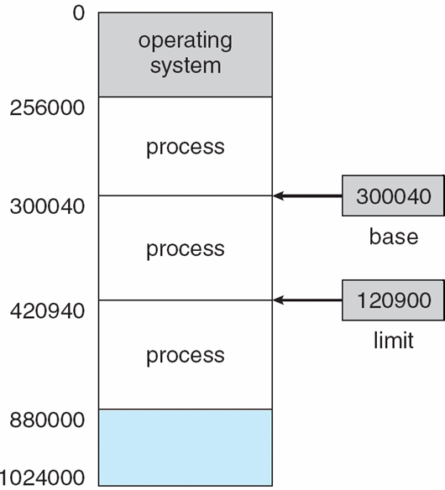
Background…
A pair of base and limit registers define the logical address space
CPU must check every memory access generated in user mode to be sure it is between base and limit for that user

Slide 7
Hardware Address Protection

Slide 8
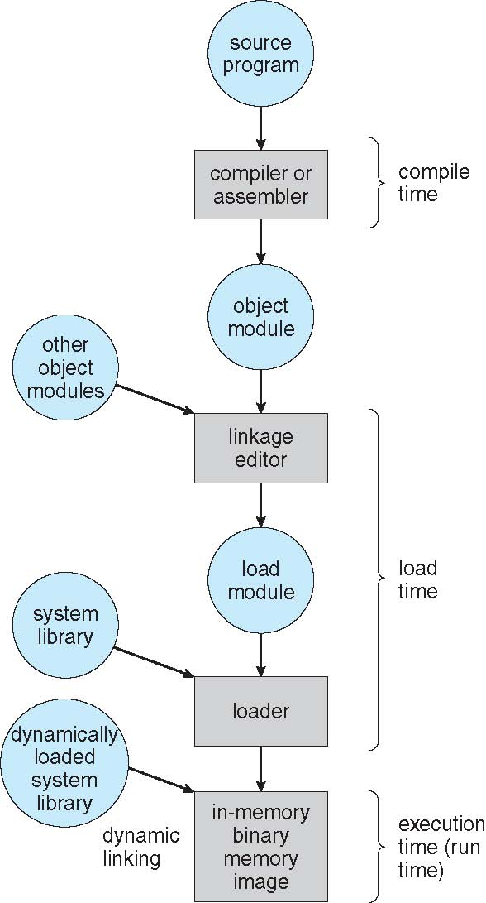
Multistep Processing of a User Program

Slide 9
Address Binding
Programs on disk, ready to be brought into memory to execute form an input queue
Without support, must be loaded into address 0000
Inconvenient to have first user process physical address always at 0000
Further, addresses represented in different ways at different stages of a program’s life
Source code addresses usually symbolic
Compiled code addresses bind to relocatable addresses
i.e. “14 bytes from beginning of this module”
Linker or loader will bind relocatable addresses to absolute addresses
i.e. 74014
Each binding maps one address space to another
Compile Time, Load time, Execution time

Slide 10
Logical vs. Physical Address Space
The concept of a logical address space that is bound to a separate physical address space is central to proper memory management
Logical address – generated by the CPU; also referred to as virtual address
Physical address – address seen by the memory unit
Logical and physical addresses are the same in compile-time and load-time address-binding schemes; logical (virtual) and physical addresses differ in execution-time address-binding scheme
Logical address space is the set of all logical addresses generated by a program
Physical address space is the set of all physical addresses generated by a program

Slide 11
Dynamic Loading
Routine is not loaded until it is called
Better memory-space utilization; unused routine is never loaded
All routines kept on disk in relocatable load format
Useful when large amounts of code are needed to handle infrequently occurring cases
No special support from the operating system is required
Implemented through program design
OS can help by providing libraries to implement dynamic loading

Slide 12
Dynamic Linking
Static linking – system libraries and program code combined by the loader into the binary program image
Dynamic linking –linking postponed until execution time
Small piece of code, stub, used to locate the appropriate memory-resident library routine
Stub replaces itself with the address of the routine, and executes the routine
Operating system checks if routine is in processes’ memory address
If not in address space, add to address space
Dynamic linking is particularly useful for libraries
System also known as shared libraries

Slide 13
Memory-Management Unit (MMU)
Hardware device that at run time maps virtual to physical address
Many methods possible, covered in the rest of this chapter
To start, consider simple scheme where the value in the relocation register is added to every address generated by a user process at the time it is sent to memory
Base register now called relocation register
The user program deals with logical addresses; it never sees the real physical addresses
Execution-time binding occurs when reference is made to location in memory
Logical address bound to physical addresses

Slide 14
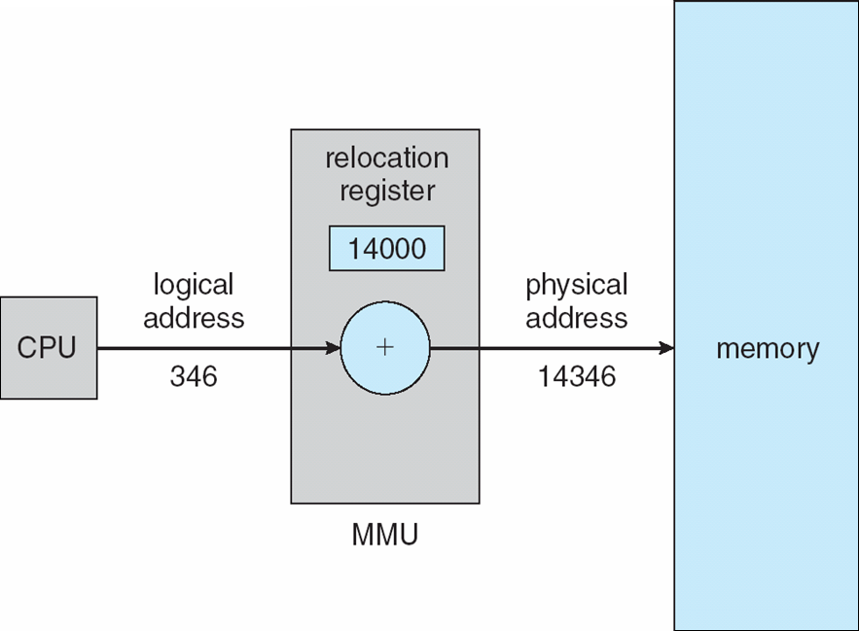
Dynamic relocation using a relocation register…

Slide 15
Swapping
A process can be swapped temporarily out of memory to a backing store, and then brought back into memory for continued execution
Total physical memory space of processes can exceed physical memory
Backing store – fast disk large enough to accommodate copies of all memory images for all users; must provide direct access to these memory images
Roll out, roll in – swapping variant used for priority-based scheduling algorithms; lower-priority process is swapped out so higher-priority process can be loaded and executed
Major part of swap time is transfer time; total transfer time is directly proportional to the amount of memory swapped
System maintains a ready queue of ready-to-run processes which have memory images on disk

Slide 16
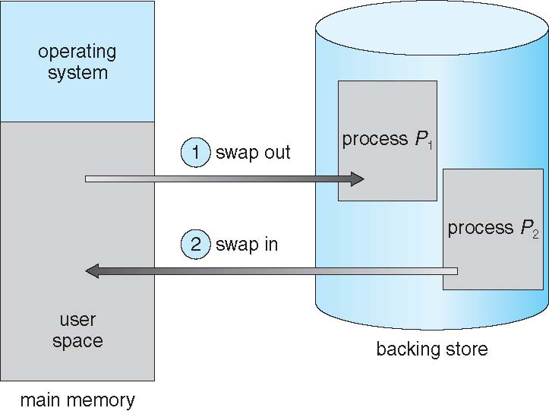
Schematic View of Swapping

Slide 17
Swapping …
Does the swapped out process need to swap back into same physical addresses?
Depends on address binding method
Modified versions of swapping are found on many systems (i.e., UNIX, Linux, and Windows)
Swapping normally disabled
Started if more than threshold amount of memory allocated
Disabled again once memory demand reduced below threshold

Slide 18
Context Switch Time including Swapping
If next processes to be put on CPU is not in memory, need to swap out a process and swap in target process
Context switch time can then be very high
100MB process swapping to hard disk with transfer rate of 50MB/sec
Swap out time of 2000 ms
Plus swap in of same sized process
Total context switch swapping component time of 4000ms (4 seconds)
Can reduce if reduce size of memory swapped – by knowing how much memory really being used
System calls to inform OS of memory use via request_memory() and release_memory()

Slide 19
Contiguous Allocation
Main memory must support both OS and user processes
Limited resource, must allocate efficiently
Contiguous allocation is one early method
Main memory usually into two partitions:
Resident operating system, usually held in low memory with interrupt vector
User processes then held in high memory
Each process contained in single contiguous section of memory

Slide 20
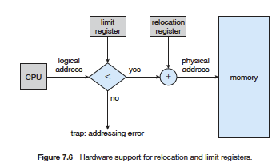
Contiguous Allocation …
Relocation registers used to protect user processes from each other, and from changing operating-system code and data
Base register contains value of smallest physical address
Limit register contains range of logical addresses – each logical address must be less than the limit register
MMU maps logical address dynamically

Slide 21
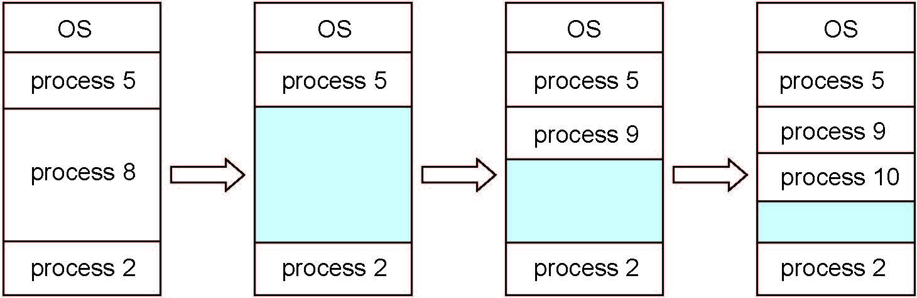
Contiguous Allocation…
Multiple-partition allocation
Degree of multiprogramming limited by number of partitions
Variable-partition sizes for efficiency (sized to a given process’ needs)
Hole – block of available memory; holes of various size are scattered throughout memory
When a process arrives, it is allocated memory from a hole large enough to accommodate it
Process exiting frees its partition, adjacent free partitions combined
Operating system maintains information about: a) allocated partitions b) free partitions (hole)
RAM
Partition Table
Memory Address | Size | Process | Usage
0x0 | 120k | 4 | In use
120k | 60k | 1 | In use
180k | 30k |  | Free
https://archive.nptel.ac.in/courses/106/106/106106144/

Slide 22
Contiguous Allocation…
As long sufficient contiguous space is available, new processes allocated memory.
RAM
Process 5 of size 20k started
Process 5 allocated RAM
Process 1 completed
Process 1 deallocated
from RAM
Partition Table
Memory Address | Size | Process | Usage
0x0 | 120k | 4 | In use
120k | 60k | 1 | In use
180k | 20k | 5 | In Use
200k | 10k |  | Free
Free

Slide 23
Contiguous Allocation…
Dynamic Storage-Allocation Problem
First-fit: Allocate the first hole that is big enough
Best-fit: Allocate the smallest hole that is big enough; must search entire list, unless ordered by size
Produces the smallest leftover hole
Worst-fit: Allocate the largest hole; must also search entire list
Produces the largest leftover hole
https://archive.nptel.ac.in/courses/106/106/106106144/
Notes:
First fit (may make fragmentation worse)
Best fit (may affect performance)

Slide 24
Fragmentation
External Fragmentation – total memory space exists to satisfy a request, but it is not contiguous
Internal Fragmentation – allocated memory may be slightly larger than requested memory; this size difference is memory internal to a partition, but not being used
RAM
New process (6) of size
65k cannot start, even
though 70k free memory
is available
Partition Table
Memory Address | Size | Process | Usage
0x0 | 120k | 4 | In use
120k | 60k |  | Free
180k | 20k | 5 | In Use
200k | 10k |  | Free

Slide 25
Fragmentation…
Reduce external fragmentation by compaction
Shuffle memory contents to place all free memory together in one large block
Compaction is possible only if relocation is dynamic, and is done at execution time

Slide 26
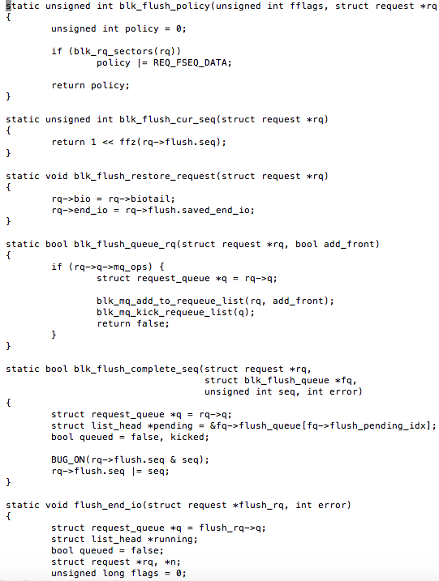
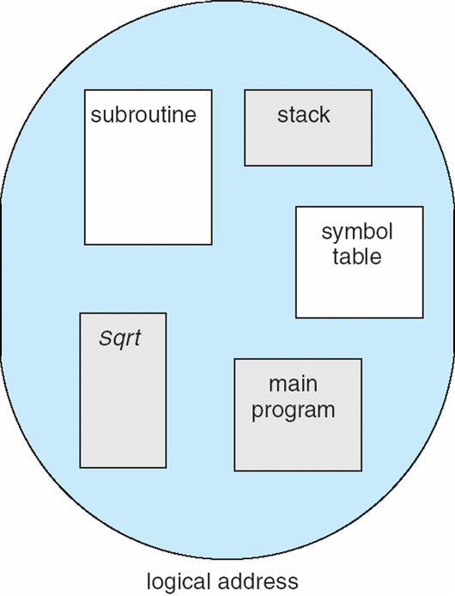
Segmentation
Memory-management scheme that supports user view of memory
A program is a collection of segments
A segment is a logical unit such as:
main program
procedure
function
method
object
local variables, global variables
common block
stack
symbol table
arrays
User’s View of a Program

Slide 27
Commonly Used Segments (an example)
Stack
stack segment
data
1
1
stack
4
Heap
heap
2
heap segment
3
Data
data segment
4
2
Text
Text
3
text segment
user space
physical memory space

Slide 28
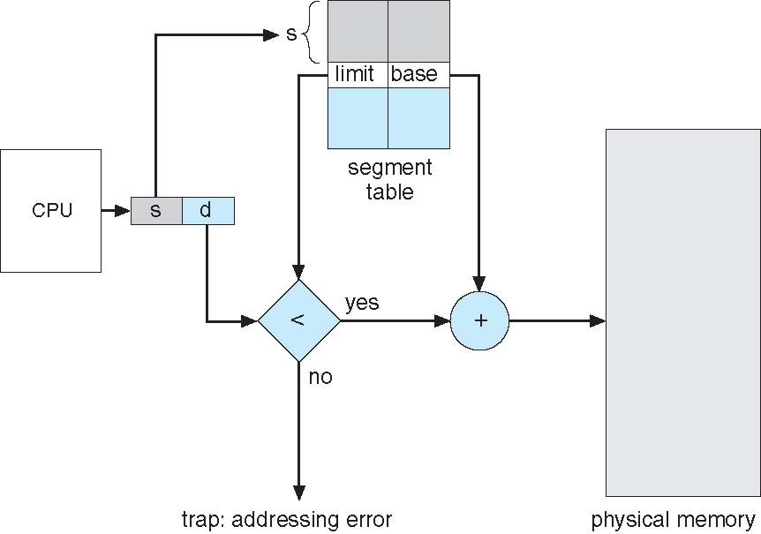
Segmentation Architecture
Logical address consists of a two tuple:
<segment-number, offset>,
Segment table – maps two-dimensional physical addresses; each table entry has:
base – contains the starting physical address where the segments reside in memory
limit – specifies the length of the segment
Segment-table base register (STBR) points to the segment table’s location in memory
Segment-table length register (STLR) indicates number of segments used by a program;
segment number s is legal if s < STLR
Segmentation Hardware

Slide 29
Segmentation Architecture …
(logical view)
RAM
(physical view)
Registers in processor
Segment Selector
data
Stack(4)
Offset register
stack
Ptr to descriptor table/ STBR
heap
Heap(3)
+
Text
(1)
Segment descriptor table (stored in memory)
Segment | Base | Limit
0
1 | 0 | 1000
2 | 3000 | 500
3 | 1500 | 500
4 | 2000 | 500
Text
https://archive.nptel.ac.in/courses/106/106/106106144/

Slide 30
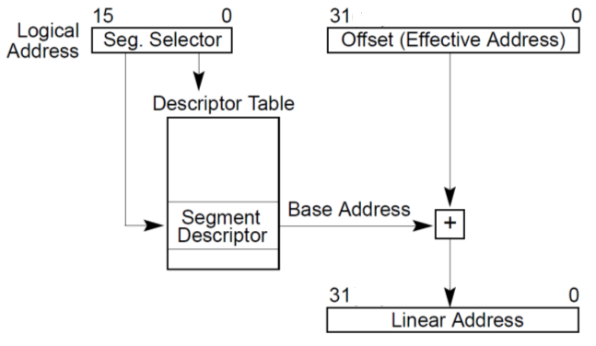
Segmentation (logical to linear address)
Stack
Logical address
Heap
Data
Text
(1)

Slide 31
Example
0x3000
0x3000
Segment | Base | Limit
0 | - | -
1 | 1000 | 1000
2 | 4000 | 500
3 | 8000 | 1000
4 | 9000 | 1000
pointer to descriptor table
Heap
10000
Stack
9000
8000
(logical address)
Data
4500
4000
3000
1
+
1100
Text
2000
segment register (eg %CS)
(effective address)
1000
100
0
offset register (eg %eip)
Address Map of Process

Slide 32
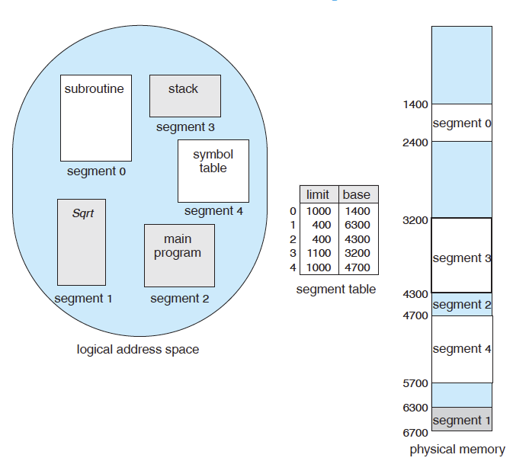
Example of segmentation
Notes:
Segment 3, 852 offset 4052
0, 1222

Slide 33
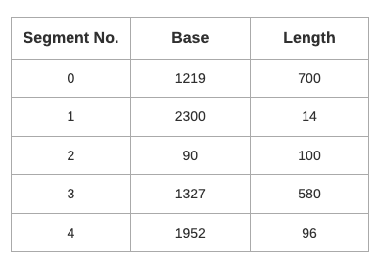
Example
Which of the following logical address will produce trap addressing error?
0, 430
1, 11
2, 100
3, 425
4, 95
Calculate the physical address if no trap is produced.
Notes:
Physical Address = 1219 + 430 = 1649
Physical Address = 2300 + 11 = 2311
Physical Address = 1327 + 425 = 1752

Slide 34
Paging
Physical address space of a process can be noncontiguous; process is allocated physical memory whenever the latter is available
Avoids external fragmentation
Avoids problem of varying sized memory chunks
Divide physical memory into fixed-sized blocks called frames
Size is power of 2, between 512 bytes and 16 Mbytes
Divide logical memory into blocks of same size called pages
Keep track of all free frames
To run a program of size N pages, need to find N free frames and load program
Set up a page table to translate logical to physical addresses
Backing store likewise split into pages
Still have Internal fragmentation

Slide 35
Paging…
RAM is split into fixed size
partitions called page frames.
Page frames typically 4KBs
Process split into blocks of equal
size.
block size = page frame size
RAM
1
process
2
1
1
3
1
2
2
4
2
3
3
5
3
4
4
6
4
5
5
7
5
6
6
Per process page table (stored in RAM)
8
6
9
block
page frame
10
1
1
11
2
2
12
3
3
13
4
4
14
5
5
6
6

Slide 36
Paging…
process1
RAM
1
1
1
2
2
2
3
3
Because of the page table,
blocks need not be in contiguous
page frames
3
4
4
4
5
5
5
6
6
6
7
process page table
Every time a memory location
is accessed, the processor looks
into the page table to identify the
corresponding page frame number.
block
block
page frame
8
page frame
1
1
14
9
1
2
2
2
10
2
3
3
13
11
3
4
4
4
12
4
5
5
1
13
5
14
6
6
8
6

Slide 37
Paging
process1
process2
process3
RAM
1
5
1
1
1
Blocks from
Several processes can share pages in RAM simultaneously
2
2
2
2
2
3
3
3
3
3
4
4
4
4
4
5
5
4
6
6
2
7
2
process page table
process page table
process page table
8
6
block
page frame
block
page frame
block
page frame
9
4
1
14
1
10
1
11
10
1
2
2
2
7
2
6
11
1
3
13
3
12
3
3
12
3
4
4
4
9
4
5
13
3
5
1
14
1
6
8

Slide 38
Address Translation Scheme
Address generated by CPU is divided into:
Page number (p) – used as an index into a page table which contains base address of each page in physical memory
Page offset (d) – combined with base address to define the physical memory address that is sent to the memory unit
For given logical address space 2^{m} and page size 2^{n}

Slide 39
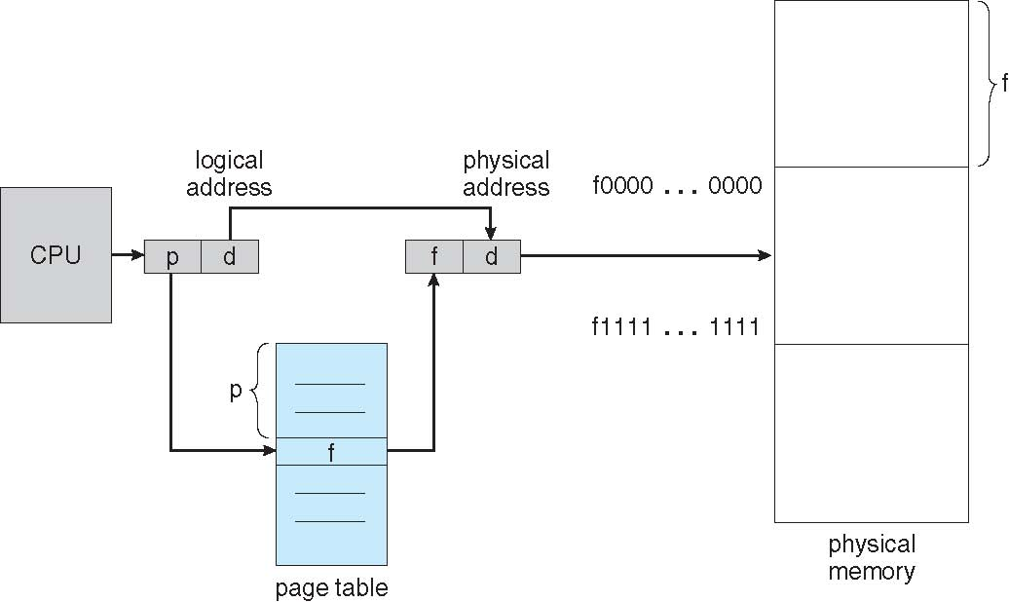
Paging Hardware

Slide 40
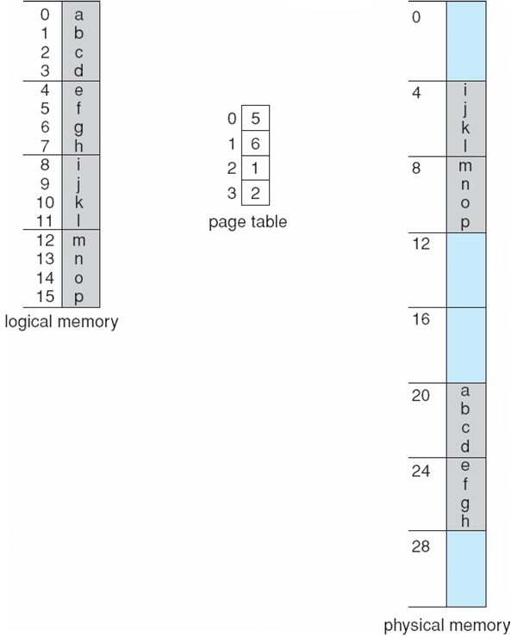
Paging Example
n=2 and m=4 32-byte memory and 4-byte pages

Slide 41
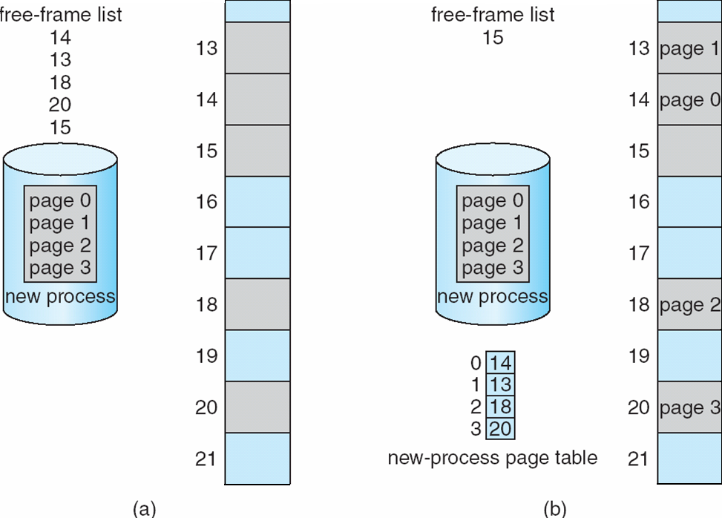
Free Frames
Before allocation
After allocation

Slide 42
Implementation of Page Table
Page table is kept in main memory
Page-table base register (PTBR) points to the page table
Page-table length register (PTLR) indicates size of the page table
In this scheme every data/instruction access requires two memory accesses
One for the page table and one for the data / instruction
The two memory access problem can be solved by the use of a special fast-lookup hardware cache called associative memory or translation look-aside buffers (TLBs)

Slide 43
Implementation of Page Table…
Some TLBs store address-space identifiers (ASIDs) in each TLB entry – uniquely identifies each process to provide address-space protection for that process
Otherwise need to flush at every context switch
TLBs typically small (64 to 1,024 entries)
On a TLB miss, value is loaded into the TLB for faster access next time
Replacement policies must be considered
Some entries can be wired down for permanent fast access

Slide 44
Associative Memory
Associative memory – parallel search
Address translation (p, d)
If p is in associative register, get frame # out
Otherwise get frame # from page table in memory

Slide 45
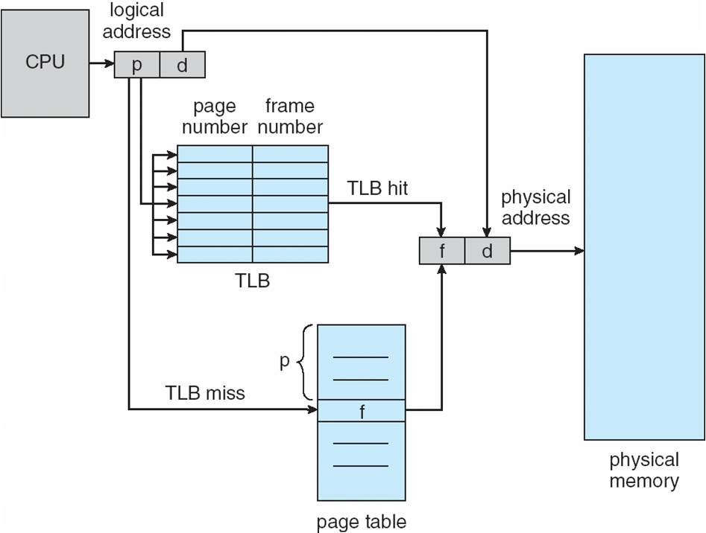
Paging Hardware With TLB

Slide 46
Effective Access Time
Associative Lookup = ε time unit
Can be < 10% of memory access time
Hit ratio = α
Hit ratio – percentage of times that a page number is found in the associative registers; ratio related to number of associative registers
Consider α = 80%, ε = 20ns for TLB search, 100ns for memory access
Effective Access Time (EAT)
EAT := TLB_miss_time * (1- α) + TLB_hit_time * α
EAT := (ε + 2 * memory_access_time) * (1- α) + (ε + memory_access_time) * α
Consider α = 80%, ε = 20ns for TLB search, 100ns for memory access
EAT = 0.80 x 120 + 0.20 x 220 = 140

Slide 47
Example
Consider a paging hardware with a TLB. Assume that the entire page table and all the pages are in the physical memory. It takes 10 milliseconds to search the TLB and 80 milliseconds to access the physical memory. If the TLB hit ratio is 0.6. What is EAT (in milliseconds)?
Notes:
122

Slide 48
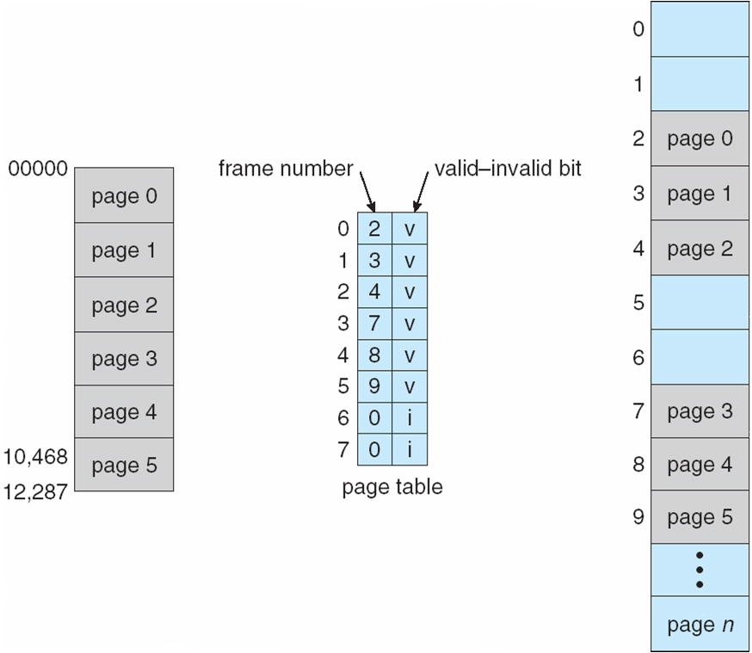
Memory Protection
Memory protection implemented by associating protection bit with each frame to indicate if read-only or read-write access is allowed
Can also add more bits to indicate page execute-only, and so on
Valid-invalid bit attached to each entry in the page table:
“valid” indicates that the associated page is in the process’ logical address space, and is thus a legal page
“invalid” indicates that the page is not in the process’ logical address space
Or use page-table length register (PTLR)
Any violations result in a trap to the kernel

Slide 49
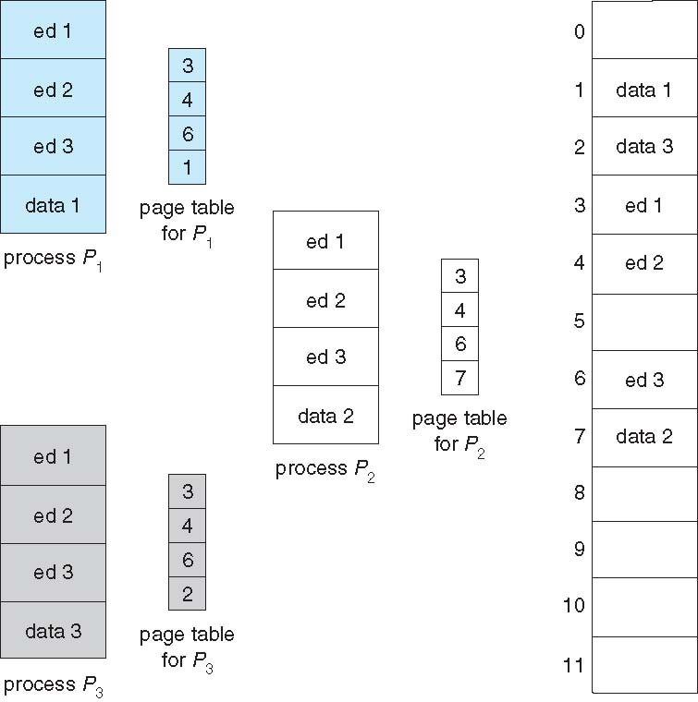
Shared Pages
Shared code
One copy of read-only (reentrant) code shared among processes (i.e., text editors, compilers, window systems)
Similar to multiple threads sharing the same process space
Also useful for interprocess communication if sharing of read-write pages is allowed
Private code and data
Each process keeps a separate copy of the code and data
The pages for the private code and data can appear anywhere in the logical address space

Slide 50
Structure of the Page Table
Memory structures for paging can get huge using straight-forward methods
Consider a 32-bit logical address space as on modern computers
Page size of 4 KB (2¹²)
Page table would have 1 million entries (2³² / 2¹²)
If each entry is 4 bytes -> 4 MB of physical address space / memory for page table alone
That amount of memory used to cost a lot
Don’t want to allocate that contiguously in main memory
Hierarchical Paging
Hashed Page Tables
Inverted Page Tables

